Slide 1



The influence of Winds and Sea Ice on the Carbon Budget and Biogeochemical Cycling of the Southern Ocean
Caitlin Encinas
Dr. Joellen Russell & Dr. Paul Goodman
University of Arizona
Arizona NASA Space Grant Symposium
2020-2021

Slide 2
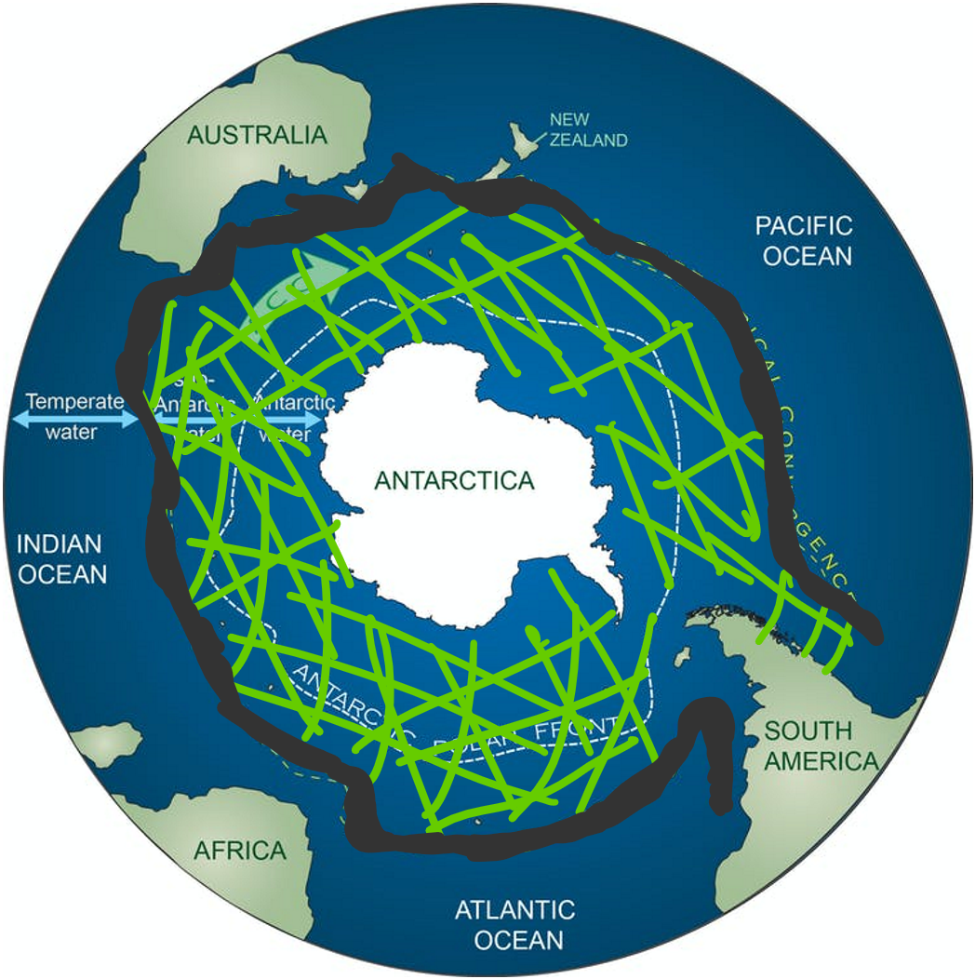
Introduction: Southern Ocean
Southern Ocean absorbs most of the anthropogenic heat and carbon
Climate Change impacts the carbon budget and nutrient circulation by modifying winds and sea ice.
Raser, C. (2016, May 26). [Image of which are the northern bounds of Antarctic and Subantarctic water]. Retrieved June 21, 2020, from https://theconversation.com/antarctica-may-not-be-as-isolated-as-we-thought-and-thats-a-worry-59969
Notes:
The Southern Ocean is located around the Antarctic continent
This area of the ocean is unique because the lack of landmasses in the ocean area allows wind to circulate these waters. Causing deep mixing
Also, this mixing allows deep water to upwell to upper ocean depths
If this circulation is changed it can prevent nutrients that come from deep ocean water layers to be trapped

Slide 3
Methods:
Examined models and observational data in the studies based on wind and sea ice changes
Models investigate and reproduce wind stress and meltwater changes
Examined for nutrient pattern changes
Notes:
Models that I chose look a show wind stress and meltwaters change, and it’s impact the Southern Ocean
We investigated how biological productivity is changing by looking at nutrient patterns. These changes are due to upwelling and stratifications in the ocean.

Slide 4
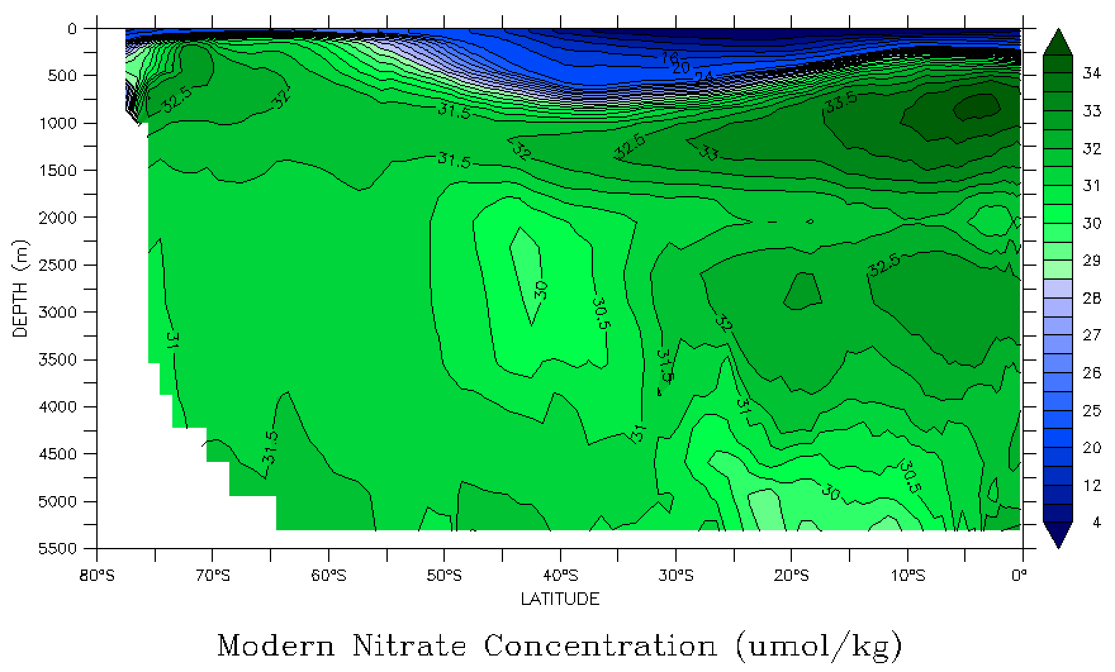
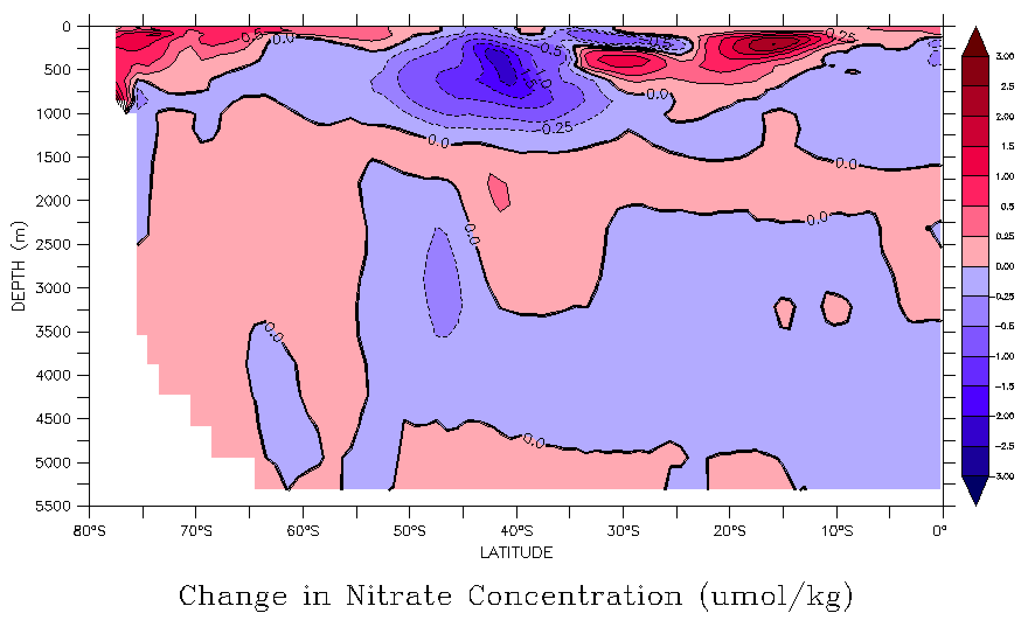
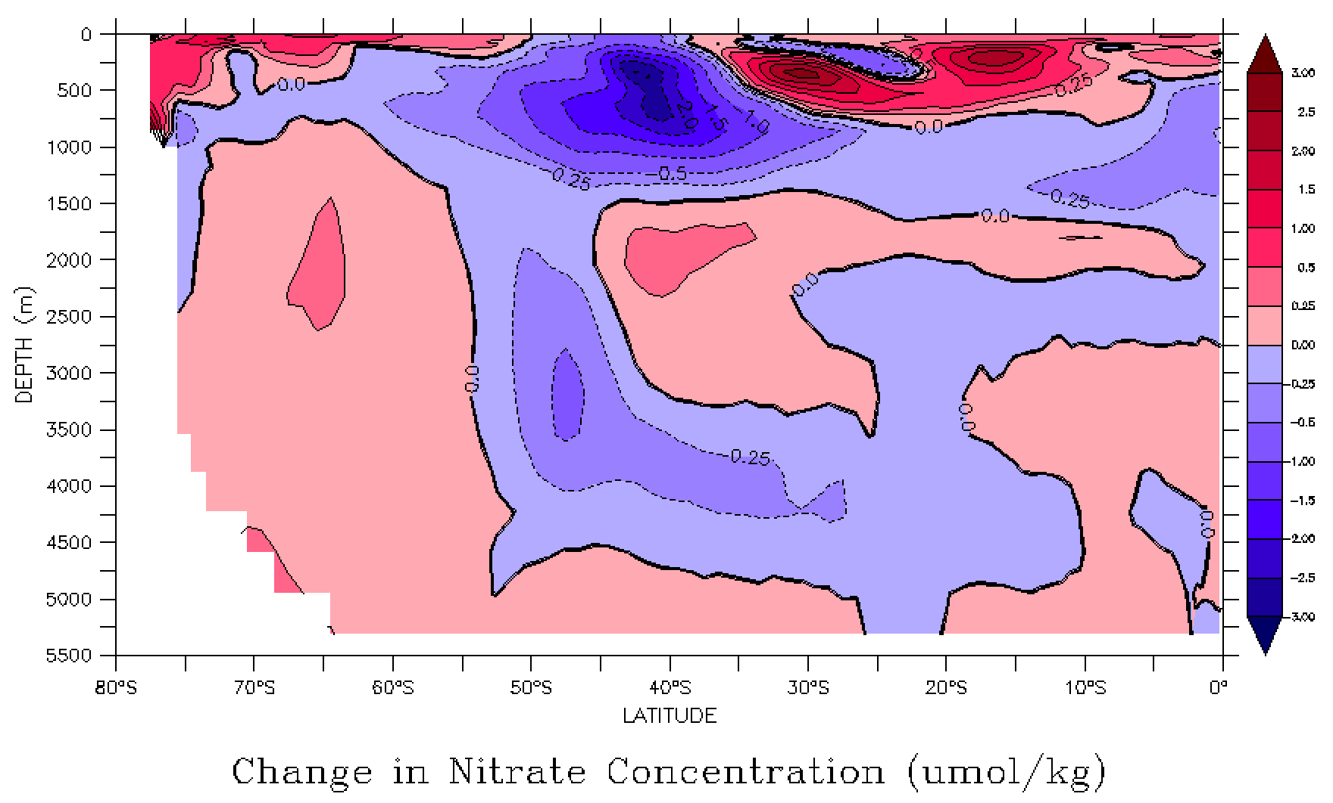
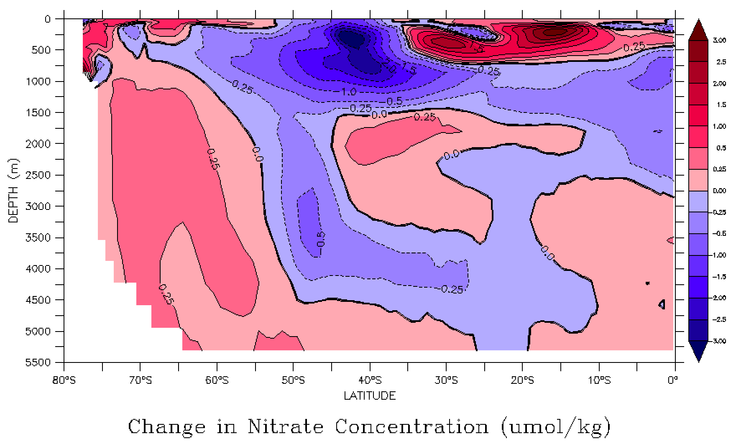
Nutrient Circulation
Warming, less upwelling
Initial (2006-2010)
Early (2016-2020)
Less nutrients, lower productivity
Middle (2031-2035)
Late (2051-2056)

Slide 5
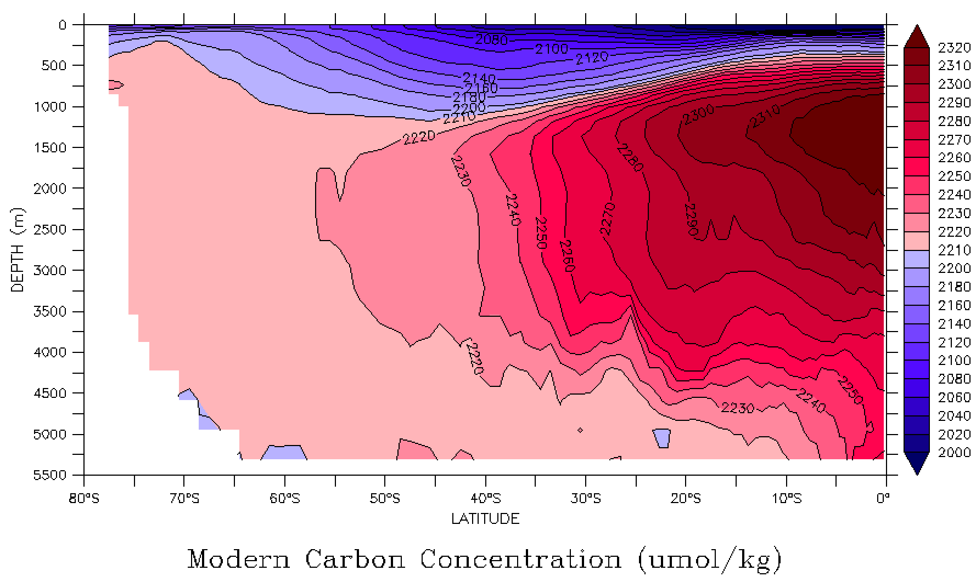
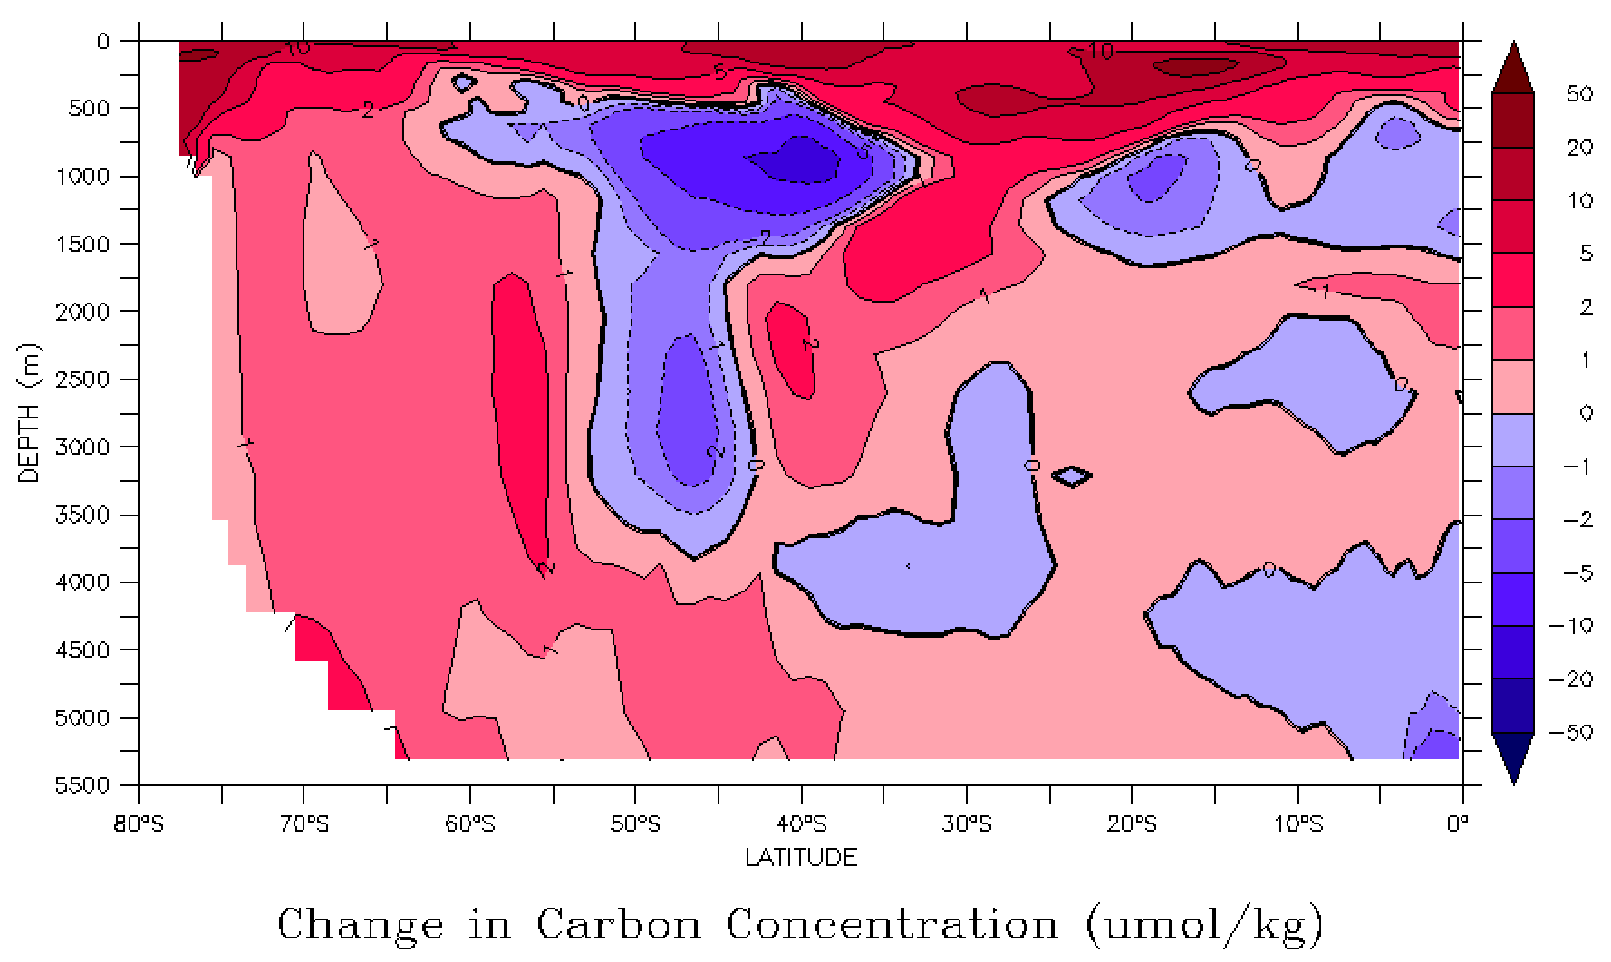
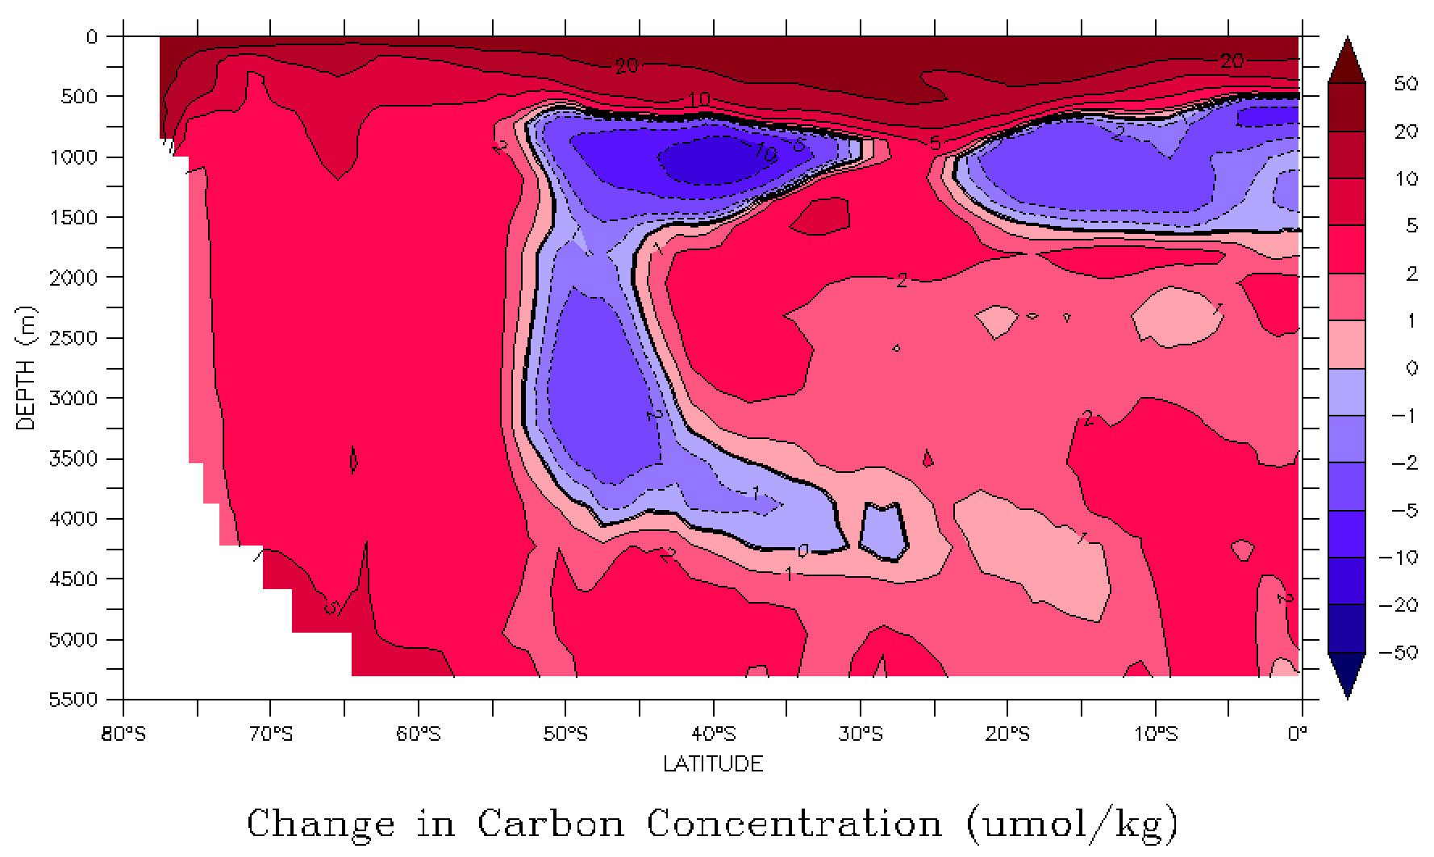
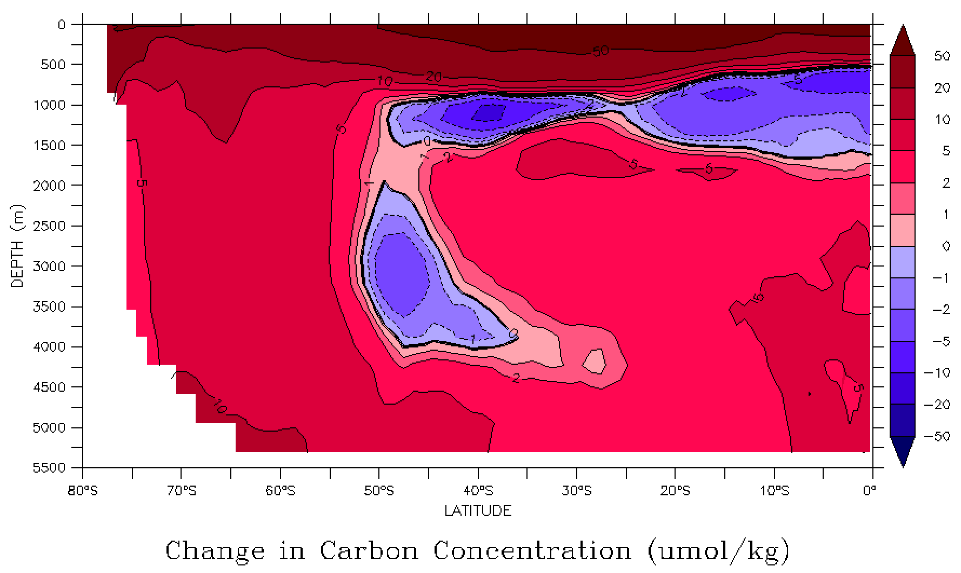
Nutrient Circulation
Warming, less upwelling
Initial (2006-2010)
Early (2016-2020)
Less nutrients, lower productivity
Middle (2031-2035)
Late (2051-2056)
Notes:
As sea ice melts it creates a fresh water layer in the stratifieds layers of the Southern ocean. This causes nutrient trapping

Slide 6
Conclusions:
Changes in winds and sea ice will lead to nutrient circulation modifications
Nutrient trapping
Upwelling zone changes
Climate change is expected to impact biological productivity
Impacts Oceanic Ecosystems
Notes:
If nutrient circulaitons occur it could lead to nutrient trapping and lower productivity in primary producers.
As winds are changing we can see upwelling zones alter with these changes. We will see circulation move with these areas. This can cause migration of species.
If we see these things occur we can see lower primary produces, and loss of that base of the food chain will cause issues to oceanic food-webs. On top of this as circulation changes organisms will need to migrate to follow the nutrients, and this is not always possible.

Slide 7
Citations:
Raser, C. (2016, May 26). [Image of which are the northern bounds of Antarctic and Subantarctic water]. Retrieved June 21, 2020, from https://theconversation.com/antarctica-may-not-be-as-isolated-as-we-thought-and-thats-a-worry-59969
Bronselaer, B., Russell, J. L., Winton, M., Williams, N. L., Key, R. M., Dunne, J. P., . . . Sarmiento, J. L. (2020). Importance of wind and meltwater for observed chemical and physical changes in the Southern Ocean. Nature Geoscience, 13(1), 35-42. doi:10.1038/s41561-019-0502-8

Slide 8
Acknowledgements
Joellen Russell, PHD
Paul Goodman, PHD
Arizona NASA Space Grant Consortium
Biogeochemical Dynamics Laboratory
Michelle Coe, Manager, Arizona/NASA Space Grant Program

Slide 9
Thank You!

